Slide 1

MCDM Approach For Diet Recommendation System
MINI PROJECT PRESENTATION
Presented By:
Karandeep : 014
Akash Gupta : 202
Manini Chawla : 354
Kunal Jain : 411
Shashank : 005(LE)
Under the guidance of :
Dr. Narina Thakur
(Associate Professor CSE)
Department of Computer Science and Engineering, BVCOE New Delhi Subject: Mini Project,

Slide 2

Table of Content
Introduction
Objectives
MCDM / AHP
Implementation
Results and Analysis
Applications
Conclusion
Future scope
Department of Computer Science and Engineering, BVCOE New Delhi Subject: Mini Project,

Slide 3

Existing system requires hiring of a dietitian in order to get consultation for our diet plan.
Hiring a dietician requires a lot of time, effort and money.
Times when the dietitian is not available for us and we would have to search for some other dietitian urgently.
So in order to escape from such problems it is ideal to use an online diet recommendation system.
PROBLEM STATEMENT
Department of Computer Science and Engineering, BVCOE New Delhi Subject: Mini Project,

Slide 4

Introduction
People are moving towards achieving a fit and healthy body and crave for healthy and nutritious food to be placed on their plates.
Diet consultation system is an application with artificial intelligence about human diets.
Data entered by the user and is processed to provide a diet plan to the user.
Analytical Hierarchical Process (AHP) of MCDM method is used to suggest the best diet for the users.
Department of Computer Science and Engineering, BVCOE New Delhi Subject: Mini Project,

Slide 5
Objectives
The goal of our mini project is to develop an online diet recommendation system for an individual to help them to maintain a healthy lifestyle.
The objectives are:-
To develop a MCDM-based diet recommendation for the user.
To maintain a balance between user preferences and nutritional needs of users.
To recommend effective diets to patients with chronic diseases and for the users aiming for losing/gaining weight.
Department of Computer Science and Engineering, BVCOE New Delhi Subject: Mini Project,

Slide 6

Approach used for solving, ‘decision making and planning problems’ involving multiple criteria.
MCDM is implemented in our diet recommendation system by taking in account several factors including height, weight, age, sex, working hours and diseases (if any) for an individual and will suggest diet accordingly.
Using AHP method of MCDM, we will recommend a list of diets to the user based on priority.
MCDM
Department of Computer Science and Engineering, BVCOE New Delhi Subject: Mini Project,

Slide 7

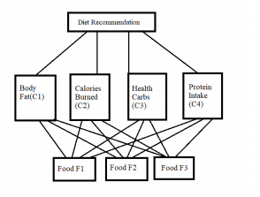
Analytic Hierarchy Process (AHP)
AHP helps decision makers find one that best suits their goal and their understanding of the problem.
Users of the AHP first decompose their decision problem into a hierarchy of sub-problems, each of which can be analyzed independently.
Figure 1 Proposed Hierarchical model
Department of Computer Science and Engineering, BVCOE New Delhi Subject: Mini Project,

Slide 8
Dataset
The Dataset is fetched from the Nutritionix API.
The Dataset contains 960 rows i.e, 960 various food items are incorporated in this project.
There are six decision parameter including body fat, calories burned, protein intake, health carbs, vegan or non-veggie, and disease, if any.
The Food Name along with the Food Serving is recommended on the basis of these decision parameters.
Department of Computer Science and Engineering, BVCOE New Delhi Subject: Mini Project,

Slide 9
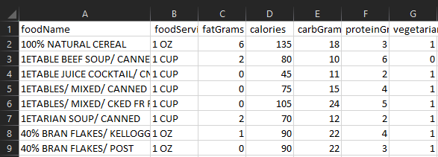
Sample Dataset
Figure 2 : Abstract of the Dataset
Department of Computer Science and Engineering, BVCOE New Delhi Subject: Mini Project,

Slide 10

Implementation
User enter the age, height, weight, sex, and Workout Hours
Flow Chart Of Our Application
Total energy expenditure,along with the calories burned,fat, protein intake and carbs are calculated
Users enter any disease they suffering from, and either they are vegan or non-veggie, and what they have eaten in that day
AHP algorithm is applied on the data
Diet is recommended on the basis of priority

Slide 11
Results and Analysis
After applying AHP method, we get the results for different criterias as shown in Table 1,2,3 and 4.
F1, F2 and F3 are the food items that are suggested for a particular user.
Nth refers to the nth root .
Eigen Vector (EV) is calculated by dividing Nth root value for the particular food divided by sum of nth root values.
Decision matrix and Normalised Performance matrix are calculated from the above results.
Food item F1 has the highest priority among the three alternatives.
Department of Computer Science and Engineering, BVCOE New Delhi Subject: Mini Project,

Slide 12
Table 1: Matrix for Body Fat
Table 2: Matrix for Calories
 | F1 | F2 | F3 | Nth | EV
F1 | 1 | 3 | 5 | 2.444 | 0.634
F2 | 1/3 | 1 | 3 | 1 | 0.259
F3 | 1/5 | 1/3 | 1 | 0.409 | 0.106
Total |  |  |  | 3.853 | 0.999
 | F1 | F2 | F3 | Nth | EV
F1 | 1 | 5 | 9 | 3.512 | 0.748
F2 | 1/5 | 1 | 3 | 0.844 | 0.179
F3 | 1/9 | 1/3 | 1 | 0.337 | 0.071
Total |  |  |  | 4.693 | 0.998
Table 3: Matrix for Health Carbs
Table 4: Matrix for Protein Intake
 | F1 | F2 | F3 | Nth | EV
F1 | 1 | 6 | 8 | 2.444 | 0.754
F2 | 1/6 | 1 | 4 | 0.606 | 0.181
F3 | 1/8 | 1/4 | 1 | 0.755 | 0.065
Total |  |  |  | 3.805 | 1.0
 | F1 | F2 | F3 | Nth | EV
F1 | 1 | 1/3 | 1/5 | 0.409 | 0.106
F2 | 3 | 1 | 1/3 | 1 | 0.259
F3 | 5 | 3 | 1 | 2.444 | 0.633
Total |  |  |  | 3.849 | 0.998

Slide 13
Table 5: Decision Matrix
0.605 | 0.726 | 0.696 | 0.102
0.291 | 0.203 | 0.239 | 0.291
0.102 | 0.069 | 0.062 | 0.605
Table 6: Normalized Performance Matrix
0.283 | 0.134 | 0.134 | 0.210 | 0.004
0.136 | 0.136 | 0.037 | 0.072 | 0.291
0.047 | 0.047 | 0.012 | 0.019 | 0.605
Table 7: Closeness Coefficient
Diet | Cci
F1 | 0.9420
F2 | 0.4305
F3 | 0.0579
Department of Computer Science and Engineering, BVCOE New Delhi Subject: Mini Project,

Slide 14

Key Benefits
Every diet is tailor-made for the user
It saves time
Help managing chronic diseases
Special guidance related to food allergies
Specially designed diet for weight management
Department of Computer Science and Engineering, BVCOE New Delhi Subject: Mini Project,

Slide 15
Conclusion
A MCDM based diet recommendation system, is proposed based on user personal data (Body type, weight, height, and working hour) and food nutritional value data.
The proposed system will recommends diet according to user's goals and health needs.
MCDM AHP algorithm is the proposed research methodology based on users data. It recommends a healthy diet to user in the form of a ranked list of food items.
The recommended diet by AHP is also, validated by using Fuzzy Topsis.
Department of Computer Science and Engineering, BVCOE New Delhi Subject: Mini Project,

Slide 16
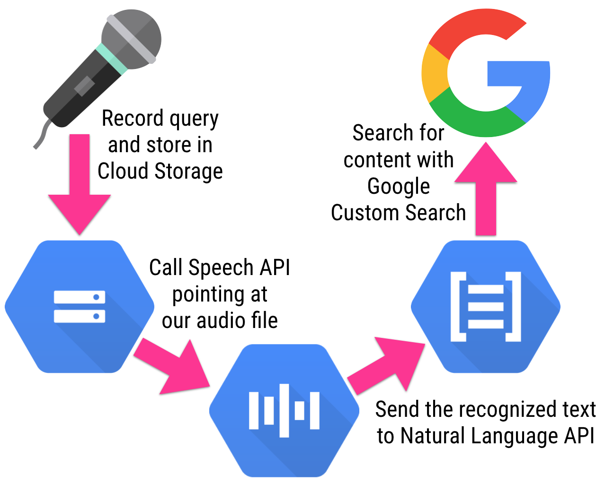
Future Scope
Speech recognition for input and output of data through NLP.
The Activity Tracker for tracking the user steps including the walking, running and stairs time along with the total step taken in a day.
Figure 3 Speech Recognition and NLP
Department of Computer Science and Engineering, BVCOE New Delhi Subject: Mini Project,

Slide 17


